Slide 1
Age-structured Models
Notes:
a

Slide 2
Estimation Methods (Overview)
Age
structure
Spatial
structure
Lumped
models
Size
structure
Trophic
interactions

Slide 3
Age-structured models
(The basics)
Applicable when:
  A growth curve (and its uncertainty) is available.
  Some age- or size-composition data are available.
  The fleets each have different selectivity patterns.
Hierarchy of age-structured models:
  Backwards methods: ADAPT-VPA; tuned VPA; XSA
  Forwards methods: Integrated Analysis (Stock Synthesis, SAM, GADGET, ASAP, Coleriane, CASAL)

Slide 4
Age-structured models
(The equations-I)
Age-structured models are as complicated as you want to
make them. The following slides outline an age-structured model with two fleets, no sex-structure, and a Beverton-Holt stock-recruitment relationship

Slide 5
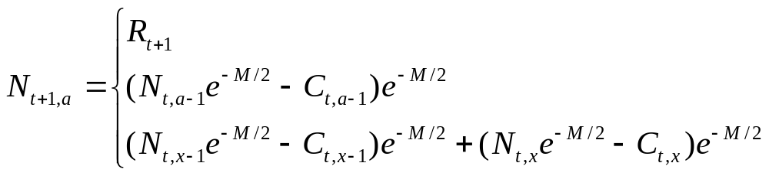
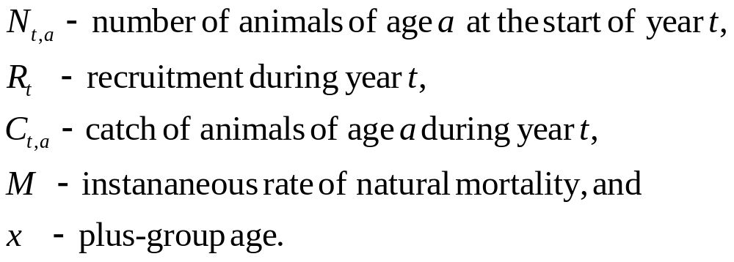
Age-structured models
(The equations-II)
Basic dynamics

Slide 6
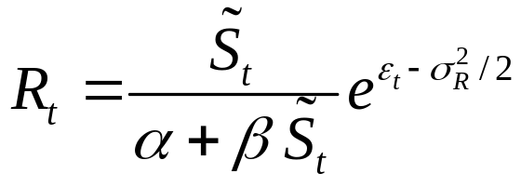
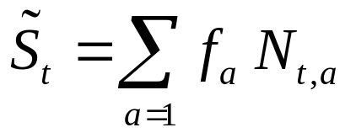
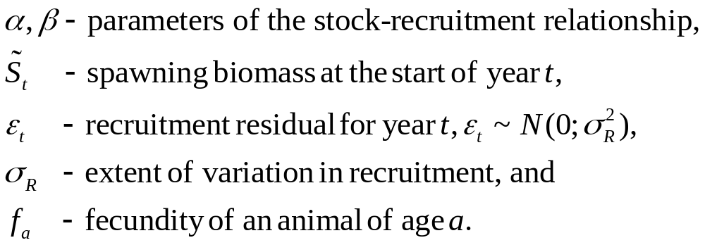
Age-structured models
(The equations-III)
Recruitment

Slide 7
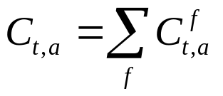

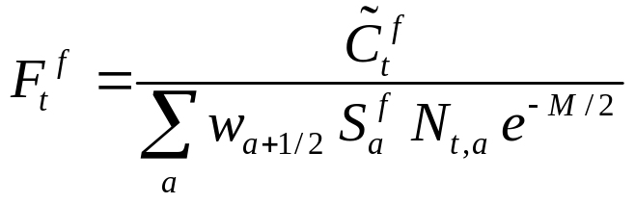
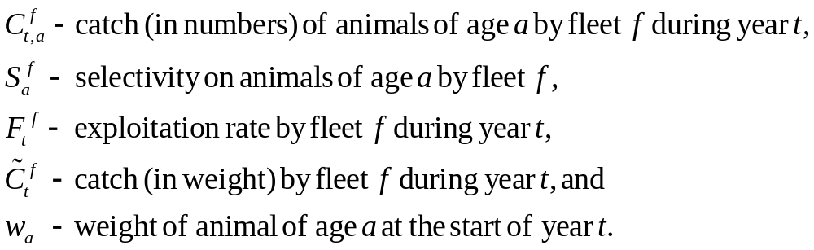
Age-structured models
(The equations-IV)
Catches

Slide 8
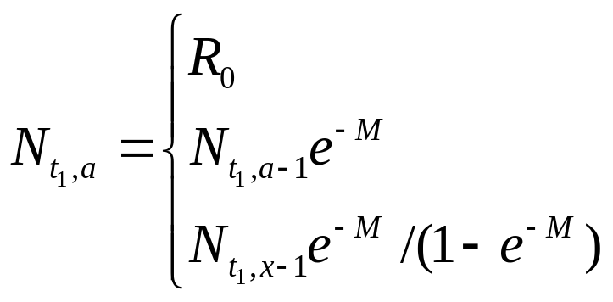
Age-structured models
(The equations-V)
Initial Conditions

Slide 9
Age-structured models
(Hints and tips on equations)
Questions arising:
  Know your assumptions - Summarize the model in terms of timing (when do things happen in the model).
  Start simple and extend as needed - How would you extend the model to allow for: a) sex-structure, b) time-varying selectivity, c) sex-change, d) a tagged population, and e) an MPA?
  The model must produce the right outputs – Does the model produce the types of outputs we need?
  Know your model parameterization – Identify the parameters of the model and how you could estimate their values?

Slide 10
Age-structured models
(The objective function-I)
The objective function is almost always case-specific (it depends on the available data). Common contributions to the objective functions include:
  indices of abundance (usually log-normal, but sometimes normal / gamma);
  catch-at-age (usually multinomial, but sometimes lognormal / robust normal / Dirichlet);
  catch-at-length (usually multinomial, but sometimes lognormal / robust normal / Dirichlet);
  discard data (discard rates and discard length- and age-composition information);
  length-at-age (usually normal);
  mean weight (usually normal); and
  indices of exploitation based on tagging data (??)

Slide 11
Age-structured models
(The objective function-II)
The objective function often also includes penalties (“priors”). The most typical of these are:
  a penalty on the recruitment residuals;
  a penalty on the extent to which selectivity varies from one year to the next;
  a penalty on the extent to which selectivity is domed-shape / monotonic; and
  priors on M and steepness.

Slide 12
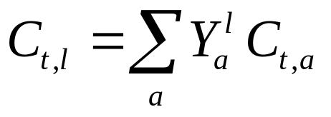
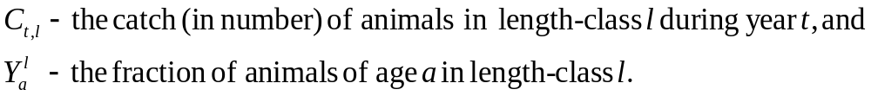
Age-structured models
(The objective function-III)
It is necessary to compute the model-estimate of the catch-
at-length when age-structured models are fitted to length-
frequency data. This is usually achieved using the formula:

Slide 13
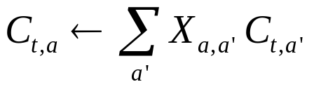
Age-structured models
(The objective function-IV)
Account can be taken of age-reading error using an
age-reading error matrix, viz:

Slide 14
Age-structured models
(Advantages and disadvantages)
Advantages:
  Far more flexibility to include realistic population dynamic processes and data in analyses.
Disadvantages:
  More complicated (mathematically and computationally) than age-lumped models.
  Flexibility makes it hard to decide “when to stop”.

Slide 15
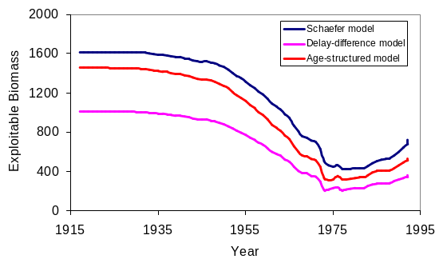
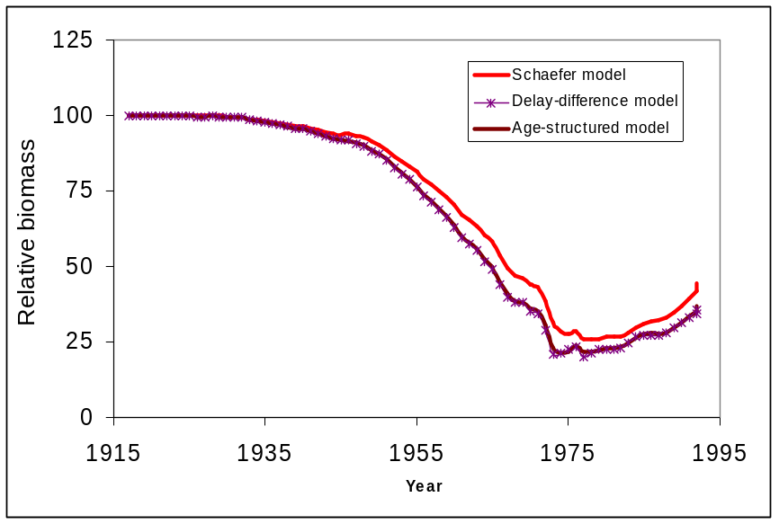
Age-structured models
(Application to Cape hake)
Results of fitting a deterministic
age-structured model to catch-rate
and survey data for Cape hake
AIC suggests that the production
model fits the data best!

Slide 16
Exercise-I
The aim of this exercise is to use simulated data to examine how well a simple age-structured model can estimate quantities of management interest as a function of the quality of the data used for parameter estimation.
The key features of the model are:
The catches are in numbers and not in mass.
Selectivity is a logistic function of age.
The numbers in the first year (year 1) and the annual recruits are taken to be parameters.

Slide 17
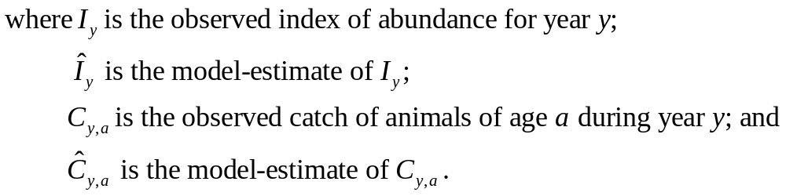
Exercise-II
The likelihood includes contributions from an index of vulnerable numbers and catches-at-age (both assumed to be log-normal). This leads to the following negative log-likelihood:

Slide 18
Exercise-III
Notes:
There is no stock-recruitment relationship or penalty on the recruitment deviations.
The extents of observation error for the abundance index and the catch-at-age data are known without error.
The index is assumed to be an absolute count.
Tasks after the lecture:
How do the results change as a function of the number of simulations – what is an appropriate number of simulations?
How do the results change as a function of the extent of observation error (SigmaI and SigmaC) and process error (SigmaR)?

